Slide 1
Session 09 : User Interfaces Using XML Layouts
Module 4.3 : Android

Slide 2
Learning Objectives
At the end of the session successful participants will be able to
Describe user interfaces using XML layouts.
Implement different Layouts in Android applications

Slide 3
User Interfaces Using XML Layouts
The Views Class
The View class represents the basic building block for user interface components.
A View occupies a rectangular area on the screen and is responsible for drawing and event handling.
View is the base class for widgets, which are used to create interactive UI components (buttons, text fields, etc.).
The ViewGroup subclass is the base class for layouts, which are invisible containers that hold other Views (or other ViewGroups) and define their layout properties.

Slide 4
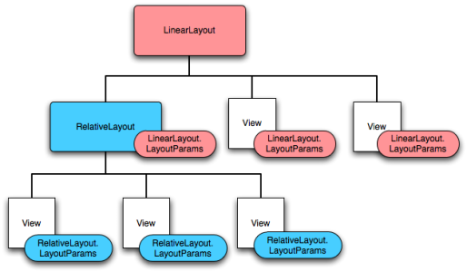
User Interfaces Using XML Layouts
Using Views
All of the views in a window are arranged in a single tree.
You can add views either from code or by specifying a tree of views in one or more XML layout files.

Slide 5
User Interfaces Using XML Layouts
Using Views
Once you have created a tree of views, there are typically a few types of common operations you may wish to perform:
Set properties
For example setting the text of a TextView. Properties that are known at build time can be set in the XML layout files.
Set focus
The framework will handled moving focus in response to user input. To force focus to a specific view, call requestFocus().

Slide 6
User Interfaces Using XML Layouts
Using Views
Once you have created a tree of views, there are typically a few types of common operations you may wish to perform:
Set up listeners
Views allow clients to set listeners that will be notified when something interesting happens to the view. For example, a Button exposes a listener to notify clients when the button is clicked.
Set visibility
You can hide or show views using setVisibility(int).

Slide 7
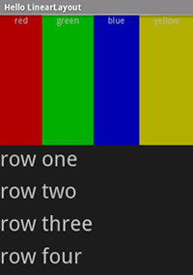
User Interfaces Using XML Layouts
A Brief Sample Of UI Components: Layout
Linear Layout
A LinearLayout is a GroupView that will lay child View elements vertically or horizontally.

Slide 8
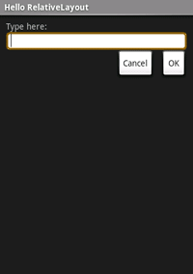
User Interfaces Using XML Layouts
A Brief Sample Of UI Components: Layout
Relative Layout
A RelativeLayout is a ViewGroup that allows you to layout child elements in positions relative to the parent or siblings elements.

Slide 9
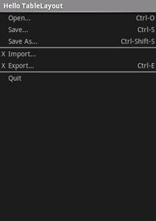
User Interfaces Using XML Layouts
A Brief Sample Of UI Components: Layout
Table Layout
A TableLayout is a ViewGroup that will lay child View elements into rows and columns.

Slide 10
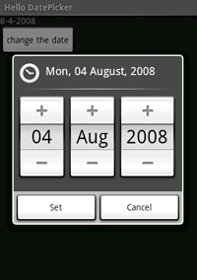
User Interfaces Using XML Layouts
A Brief Sample Of UI Components: Widgets
DatePicker
A DatePicke is a widget that allows the user to select a month, day and year.

Slide 11
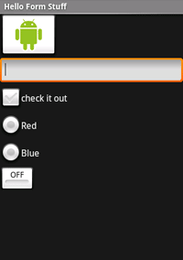
User Interfaces Using XML Layouts
A Brief Sample Of UI Components: Widgets
Form Controls
Includes a variety of typical form widgets, like:
Image buttons,
Text fields,
Checkboxes, and
Radio buttons

Slide 12
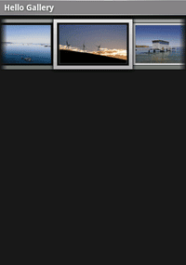
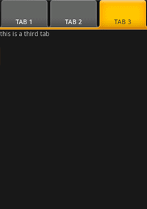
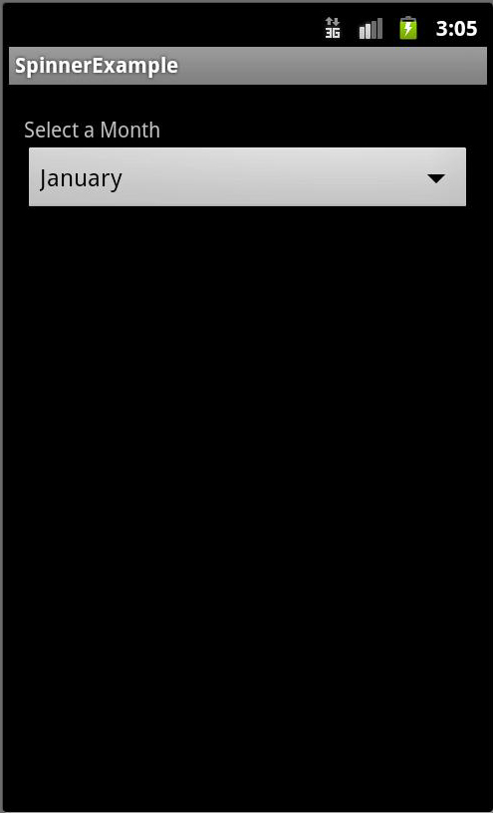
User Interfaces Using XML Layouts
A Brief Sample Of UI Components: Widgets
Gallery View
TabWidget
Spinner

Slide 13
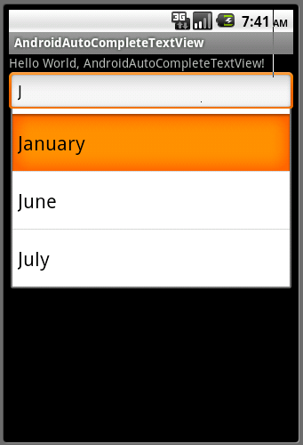
User Interfaces Using XML Layouts
A Brief Sample Of UI Components: Widgets
AutoCompleteTextView
It is a version of the EditText widget that will provide auto-complete suggestions as the user types. The suggestions are extracted from a collection of strings.

Slide 14
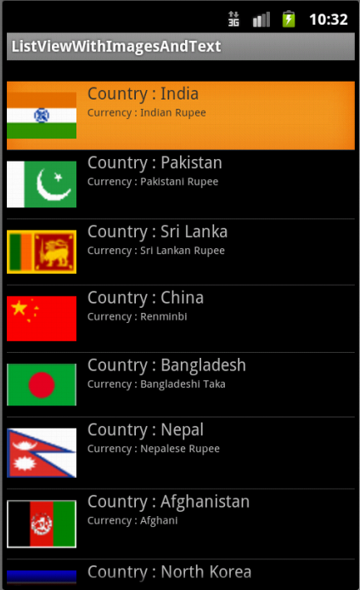
User Interfaces Using XML Layouts
A Brief Sample Of UI Components: Widgets
ListView
A ListView is a View that shows items in a vertically scrolling list. The items are acquired from a ListAdapter.

Slide 15
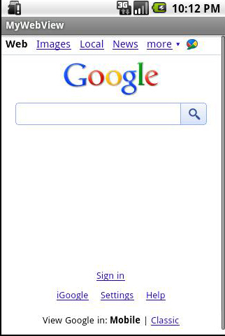
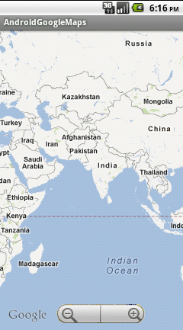
User Interfaces Using XML Layouts
A Brief Sample Of UI Components: Widgets
WebView
MapView

Slide 16
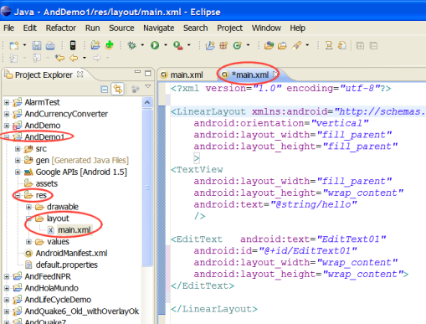
User Interfaces Using XML Layouts
What is An XML Layout?
An XML-based layout is a specification of the various UI components (widgets) and the relationships to each other – and to their containers – all written in XML format.

Slide 17
User Interfaces Using XML Layouts
What is An XML Layout?
Android considers XML-based layouts to be resources, and as such layout files are stored in the res/layout directory inside your Android project.

Slide 18
User Interfaces Using XML Layouts
What is An XML Layout?
Each XML file contains a tree of elements specifying a layout of widgets and containers that make up one View.
The attributes of the XML elements are properties, describing widget look or behavior.
Example:
If a Button element has an attribute value of
android:textStyle= "bold“
It means that the text appearing on the face of the button should be rendered in a boldface font style.

Slide 19
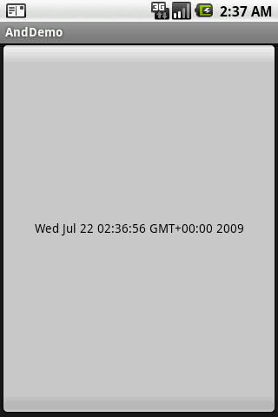
User Interfaces Using XML Layouts
What is An XML Layout?: Example
The application places a button to occupy the screen. When clicked the button’s text shows current time.
importjava.util.Date;
importandroid.app.Activity;
importandroid.os.Bundle;
importandroid.view.View;
importandroid.view.View.OnClickListener;
importandroid.widget.Button;
publicclassAndDemoextendsActivity {
Button btn;
@Override
publicvoidonCreate(Bundle icicle) {
super.onCreate(icicle);

Slide 20
User Interfaces Using XML Layouts
What is An XML Layout?: Example
The application places a button to occupy the screen. When clicked the button’s text shows current time.
setContentView(R.layout.main);
btn= (Button) findViewById(R.id.myButton);
btn.setOnClickListener(newOnClickListener() {
@Override
publicvoidonClick(View v) {
updateTime();
}});
}// onCreate
//
privatevoidupdateTime() {
btn.setText(newDate().toString());}}

Slide 21
User Interfaces Using XML Layouts
What is An XML Layout?: Example
This is the XML-Layout definition
<?xmlversion="1.0"encoding="utf-8"?>
<Buttonxmlns:android="http://schemas.android.com/apk/res/android"
android:id="@+id/myButton"
android:text=""
android:layout_width="fill_parent"
android:layout_height="fill_parent"
/>

Slide 22
User Interfaces Using XML Layouts
What is An XML Layout?: Example
The root element needs to declare the Android XML namespace:
xmlns:android="http://schemas.android.com/apk/res/android"
All other elements will be children of the root and will inherit that namespace declaration.
Because we want to reference this button from our Java code, we need to give it an identifier via the android:id attribute.

Slide 23
User Interfaces Using XML Layouts
What is An XML Layout?: Example
<?xmlversion="1.0"encoding="utf-8"?>
<Button
xmlns:android="http://schemas.android.com/apk/res/android"
android:id="@+id/myButton"
android:text=""
android:layout_width="fill_parent"
android:layout_height="fill_parent"
/>

Slide 24
User Interfaces Using XML Layouts
What is An XML Layout?: Example
The remaining attributes are properties of this Button instance:
android:text indicates the initial text to be displayed on the button face (in this case, an empty string)
android:layout_width and android:layout_height tell Android to have the button's width and height fill the "parent“ container, in this case the entire screen.

Slide 25
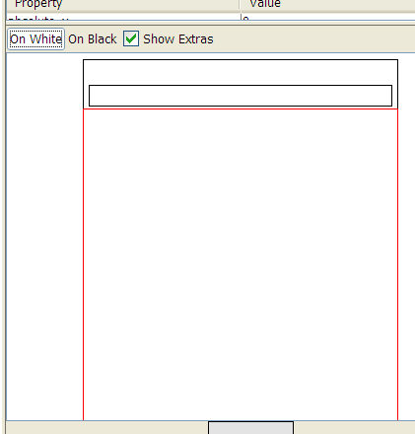
User Interfaces Using XML Layouts
UI Hierarchy
PhoneWindow$DecorView #0@437360b8 NO_ID
LinearLayout #0@43736878 NO_ID
Button #0@437388b0 id/button
TextView #0@43736b0 id/title
FrameLayout #0@437370c8 NO_ID
FrameLayout #1@437381f0 id/content

Slide 26
User Interfaces Using XML Layouts
UI Hierarchy
The HierarchyViewer displays all the UI elements on the screen.
It includes the top caption as TextView held in its own FrameLayout, as well as our Button in its FrameLayou.
Both are part of a higher LinearLayoutwhich renders all elements of the PhoneWindowView.

Slide 27
User Interfaces Using XML Layouts
Android Layouts
The most common way to define your layout and express the view hierarchy is with an XML layout file.
XML offers a human-readable structure for the layout, much like HTML.

Slide 28
User Interfaces Using XML Layouts
Android Layouts
Each element in XML is either a View or ViewGroup object
ViewGroup
View
View
View
ViewGroup
View
View

Slide 29
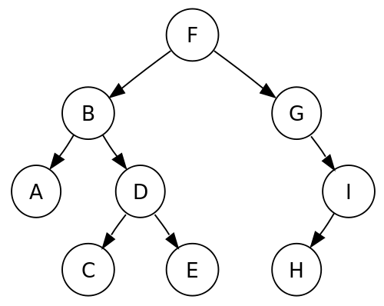
User Interfaces Using XML Layouts
Android Layouts
The Android UI Framework paints the screen by walking the View tree by asking each component to draw itself in a pre-order traversal way.
Displaying The Application’s View

Slide 30
User Interfaces Using XML Layouts
Android Layouts
Displaying the Application’s View
Each component draws itself and then asks each of its children to do the same.

Slide 31
User Interfaces Using XML Layouts
Android Layouts
Displaying the Application’s View
When the whole tree has been rendered, the smaller, nested components that are the leaves of the tree –and that were, therefore, painted later –appear to be drawn on top of the components that are nearer to the root and that were painted earlier.

Slide 32
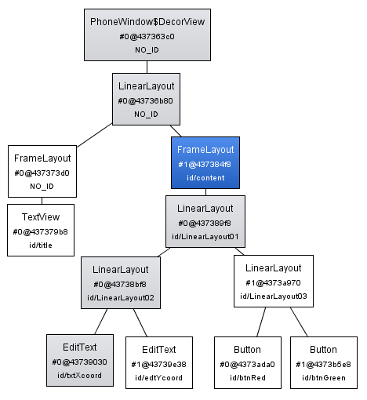
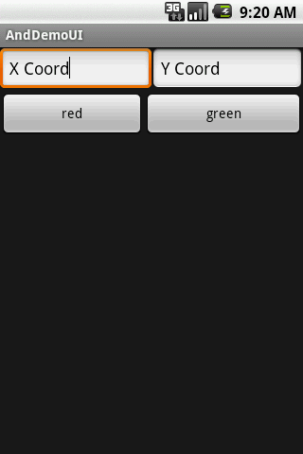
User Interfaces Using XML Layouts
Example: Display UI Hierarchy
Vertical
Horizontal
Horizontal

Slide 33
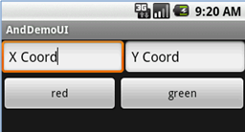
User Interfaces Using XML Layouts
Example: Display UI Hierarchy
<?xml version="1.0" encoding="utf-8"?>
<LinearLayoutandroid:id="@+id/LinearLayout01"
android:layout_width="fill_parent" android:layout_height="fill_parent"
android:orientation="vertical" xmlns:android="http://schemas.android.com/apk/res/android">
<LinearLayoutandroid:id="@+id/LinearLayout02"
android:layout_width="fill_parent" android:layout_height="wrap_content">
<EditTextandroid:id="@+id/txtXcoord" android:layout_width="wrap_content"
android:layout_height="wrap_content" android:text="X Coord"
android:layout_weight="1“>

Slide 34
User Interfaces Using XML Layouts
Example: Display UI Hierarchy
</EditText>
<EditTextandroid:id="@+id/edtYcoord" android:layout_width="wrap_content"
android:layout_height="wrap_content" android:text="Y Coord"
android:layout_weight="1">
</EditText>
</LinearLayout>
<LinearLayoutandroid:id="@+id/LinearLayout03"
android:layout_width="fill_parent" android:layout_height="wrap_content">
<Button android:id="@+id/btnRed" android:layout_width="wrap_content"
android:layout_height="wrap_content" android:text="red”

Slide 35
User Interfaces Using XML Layouts
Example: Display UI Hierarchy
android:layout_weight="1">
</Button>
<Button android:id="@+id/btnGreen" android:layout_width="wrap_content"
android:layout_height="wrap_content" android:text="green"
android:layout_weight="1">
</Button>
</LinearLayout>
</LinearLayout>

Slide 36
User Interfaces Using XML Layouts
Common Layouts
There are five basic types of Layouts:
FrameLayout
LinearLayout
RelativeLayout
TableLayout
AbsoluteLayout

Slide 37
User Interfaces Using XML Layouts
Common Layouts
FrameLayout
FrameLayout is the simplest type of layout object.
It's basically a blank space on your screen that you can later fill with a single object — for example, a picture that you'll swap in and out.

Slide 38
User Interfaces Using XML Layouts
Common Layouts
FrameLayout
All child elements of the FrameLayout are pinned to the top left corner of the screen; you cannot specify a different location for a child view.
Subsequent child views will simply be drawn over previous ones, partially or totally obscuring them (unless the newer object is transparent).

Slide 39
User Interfaces Using XML Layouts
Common Layouts
LinearLayout
LinearLayout aligns all children in a single direction — vertically or horizontally depending on the android:orientation attribute.
Vertical Orientation
Horizontal Orientation

Slide 40
User Interfaces Using XML Layouts
Common Layouts
LinearLayout
All children are stacked one after the other, so a:
vertical list will only have one child per row, no matter how wide they are, and a
horizontal list will only be one row high (the height of the tallest child, plus padding)
A LinearLayout respects margins between children and the gravity(right, center, or left alignment) of each child.

Slide 41
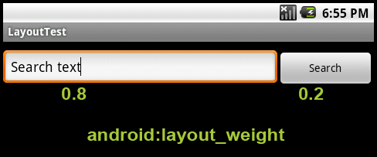
User Interfaces Using XML Layouts
Common Layouts
LinearLayout
You may attribute a weight to children of a LinearLayout.
Weight gives an "importance" value to a view, and allows it to expand to fill any remaining space in the parent view.

Slide 42
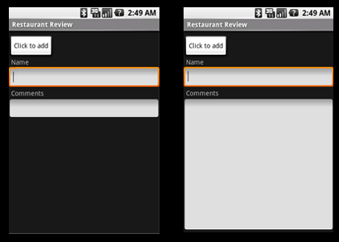
User Interfaces Using XML Layouts
Common Layouts
LinearLayout: Example
The following two forms represent a LinearLayout with a set of elements
They includes, a button, some labels and text boxes.
The text boxes have width set to fill_parent; other elements are set to wrap_content. The gravity, by default, is left.

Slide 43
User Interfaces Using XML Layouts
Common Layouts
LinearLayout: Example
The difference between the two versions of the form:
Left side form has weight values unset (0 by default),
Right side form has the comments text box weight set to 1.

Slide 44
User Interfaces Using XML Layouts
Common Layouts
LinearLayout: Example
The difference between the two versions of the form:
If the Name textbox had also been set to 1, the Name and Comments text boxes would be the same height.

Slide 45
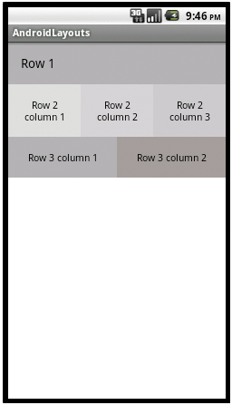
User Interfaces Using XML Layouts
Common Layouts
TableLayout
TableLayout positions its children into rows and columns.
TableLayout containers do not display border lines for rows, columns, or cells.
The table will have as many columns as the row with the most cells.
A table can leave cells empty, but cells cannot span columns, as in HTML.

Slide 46
User Interfaces Using XML Layouts
Common Layouts
TableLayout
TableRow objects are the child views of a TableLayout (each TableRow defines a single row in the table).
Each row has zero or more cells, each of which is defined by any kind of other View.
So, the cells of a row may be composed of a variety of View objects, like ImageView or TextView objects.

Slide 47
User Interfaces Using XML Layouts
Common Layouts
TableLayout
A cell may also be a ViewGroup object (for example, you can nest another TableLayout as a cell).

Slide 48
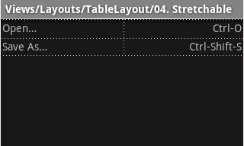
User Interfaces Using XML Layouts
Common Layouts
TableLayout
<?xml version="1.0" encoding="utf-8"?>
<TableLayout
xmlns:android="http://schemas.android.com/apk/res/android"
android:layout_width="fill_parent"
android:layout_height="fill_parent"
android:stretchColumns="*">
<TableRow>
<TextViewandroid:text="Open…"
android:padding="3dip" />
<TextViewandroid:text="Ctrl-O"
android:gravity="right”
The following sample layout has two rows and two cells in each. The accompanying screenshot shows the result, with cell borders displayed as dotted lines (added for visual effect).

Slide 49
User Interfaces Using XML Layouts
Common Layouts
TableLayout
android:padding="3dip" />
</TableRow>
<TableRow>
<TextViewandroid:text="Save As…"
android:padding="3dip" />
<TextViewandroid:text="Ctrl-Shift-S"
android:gravity="right"
android:padding="3dip" />
</TableRow>
</TableLayout>
The following sample layout has two rows and two cells in each. The accompanying screenshot shows the result, with cell borders displayed as dotted lines (added for visual effect).

Slide 50
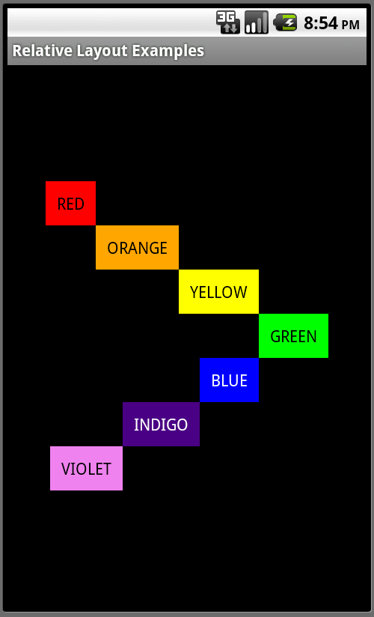
User Interfaces Using XML Layouts
Common Layouts
RelativeLayout
RelativeLayout lets child views specify their position relative to the parent view or to each other(specified by ID).
You can align two elements by right border, or make one below another, centered in the screen, centered left, and so on.

Slide 51
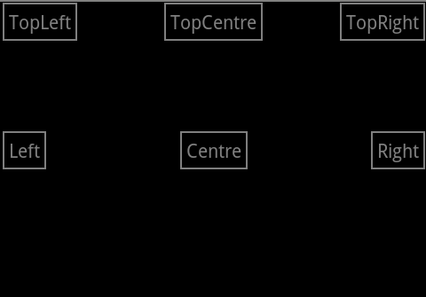
User Interfaces Using XML Layouts
Common Layouts
RelativeLayout
Elements are rendered in the order given, so if the first element is centered in the screen, other elements aligning themselves to that element

Slide 52
User Interfaces Using XML Layouts
Common Layouts
RelativeLayout
Because of ordering, if using XML to specify this layout, the element that you will reference (in order to position other view objects) must be listed in the XML file before you refer to it from the other views via its reference ID.

Slide 53
User Interfaces Using XML Layouts
Common Layouts
RelativeLayout
RelativeLayout Parameters
width | height
below | above
alignTop | alignParentTop
alignBottom | alignParentBottom
toLeftOf | toRightOf
padding [Bottom | Left | Right | Top]
margin [Bottom | Left | Right | Top]
Example: Assigning the parameter to a TextView would place the TextView to the left of the View with the ID my_button
android:layout_toLeftOf=“@+id/my_button"

Slide 54
User Interfaces Using XML Layouts
Common Layouts
RelativeLayout
RelativeLayout Parameters
width | height
below | above
alignTop | alignParentTop
alignBottom | alignParentBottom
toLeftOf | toRightOf
padding [Bottom | Left | Right | Top]
margin [Bottom | Left | Right | Top]
Example: Assigning the parameter to a TextView would place the TextView to the left of the View with the ID my_button
android:layout_toLeftOf=“@+id/my_button"

Slide 55
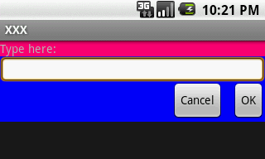
User Interfaces Using XML Layouts
Common Layouts
RelativeLayout
<?xml version="1.0" encoding="utf-8"?>
<RelativeLayout
xmlns:android="http://schemas.android.com/apk/res/android"
android:layout_width="fill_parent"
android:layout_height="wrap_content"
android:background="#ff0000ff"
android:padding="10px" >
<TextViewandroid:id="@+id/label"
android:layout_width="fill_parent"
android:layout_height="wrap_content"
android:background="#ffff0077”
The attributes that refer to relative elements (e.g., layout_toLeft) refer to the ID using the syntax of a relative resource (@id/id).

Slide 56
User Interfaces Using XML Layouts
Common Layouts
RelativeLayout
android:text="Type here:" />
<EditTextandroid:id="@+id/entry"
android:layout_width="fill_parent"
android:layout_height="wrap_content"
android:layout_below="@id/label" />
<Button
android:id="@+id/ok"
android:layout_width="wrap_content"
android:layout_height="wrap_content"
android:layout_below="@id/entry"
android:layout_alignParentRight="true"
android:layout_marginLeft="10px”
The attributes that refer to relative elements (e.g., layout_toLeft) refer to the ID using the syntax of a relative resource (@id/id).

Slide 57
User Interfaces Using XML Layouts
Common Layouts
RelativeLayout
android:text="OK" />
<Button
android:text="Cancel"
android:layout_width="wrap_content"
android:layout_height="wrap_content"
android:layout_toLeftOf="@id/ok"
android:layout_alignTop="@id/ok“ />
</RelativeLayout>
The attributes that refer to relative elements (e.g., layout_toLeft) refer to the ID using the syntax of a relative resource (@id/id).

Slide 58
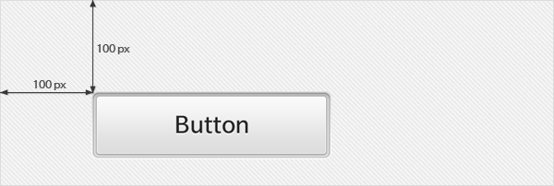
User Interfaces Using XML Layouts
Common Layouts
AbsoluteLayout
A layout that lets you specify exact locations (x/y coordinates) of its children. Absolute layouts are less flexible and harder to maintain than other types of layouts without absolute positioning.

Slide 59
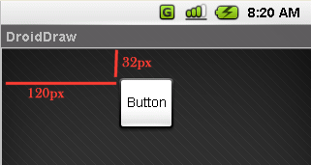
User Interfaces Using XML Layouts
Common Layouts
AbsoluteLayout
<?xml version="1.0" encoding="utf-8"?>
<AbsoluteLayout
android:id="@+id/myAbsoluteLayout"
android:layout_width="fill_parent"
android:layout_height="fill_parent"
xmlns:android="http://schemas.android.com/apk/res/android" >
<Button
android:id="@+id/myButton"
android:layout_width="wrap_content"
android:layout_height="wrap_content"
android:text="Button”

Slide 60
User Interfaces Using XML Layouts
Common Layouts
AbsoluteLayout
android:layout_x=“120px"
android:layout_y=“32px"
>
</Button>
</AbsoluteLayout>

